Slide 1
Corkbuzz
Union Square
New York
November 30, 2021
Case History:
Discovering the Cava PDO

Slide 2
What is TTD.EU about?
Quality wines from the heart of Europe
Objectives
Increase the awareness among industry members, media and consumers of European Quality Schemes (PDO and PGI) and the related logos.
Enhance the competitiveness of European quality wines with PDO and PGI designations.
Growth market share of European quality wines with PDO and PGI designations.
European Quality Wines: Taste The Difference+ is a three-year project financed by the European Union and managed by Unione Italiana Vini and Prodeca for the promotion of PDO and PGI European wines abroad in China and US.

Slide 3
Beneficiaries
Quality wines from the heart of Europe
PRODECA, Promotora de las Exportacions Catalanes
It's a public company established in 1986 and part of the “Ministry of Climate Action, Food and Rural Agenda of the Government of Catalonia”.
It supports the agri-food sector and its companies with the knowledge, tools and experience to increase their products in Catalonia and worldwide.

Slide 4
How to recognize EU Quality Schemes?
Quality wines from the heart of Europe
Quality wines from the heart of Europe
PDO – Protected Designation of Origin
PGI – Protected Geographical Indication
PDO and PGI designated wines are considered to be high-quality product, produced in accordance with national and European regulations.
The EU Geographical indications system protects the names of products that originate from specific regions and have specific qualities or enjoy a reputation linked to the production territory.

Slide 5
What does a PDO /PGI guarantee?
Quality wines from the heart of Europe
Quality assurance
Food safety
Traceability
Authenticity
Animal protection
Respect the environment
Sustainability
Origin
Terroir
Any food, beverage or agricultural products displaying PDO and PGI logos on their labels gives consumers an indication that the quality of such products is guaranteed.
They are a guarantee that products have undergone strict quality controls, enforced by the EU.
The quality controls ensure food safety, traceability, authenticity, animal wellbeing, labelling accuracy and nutrition protection, preserving product characteristics of quality, taste, tradition and diversity.

Slide 6
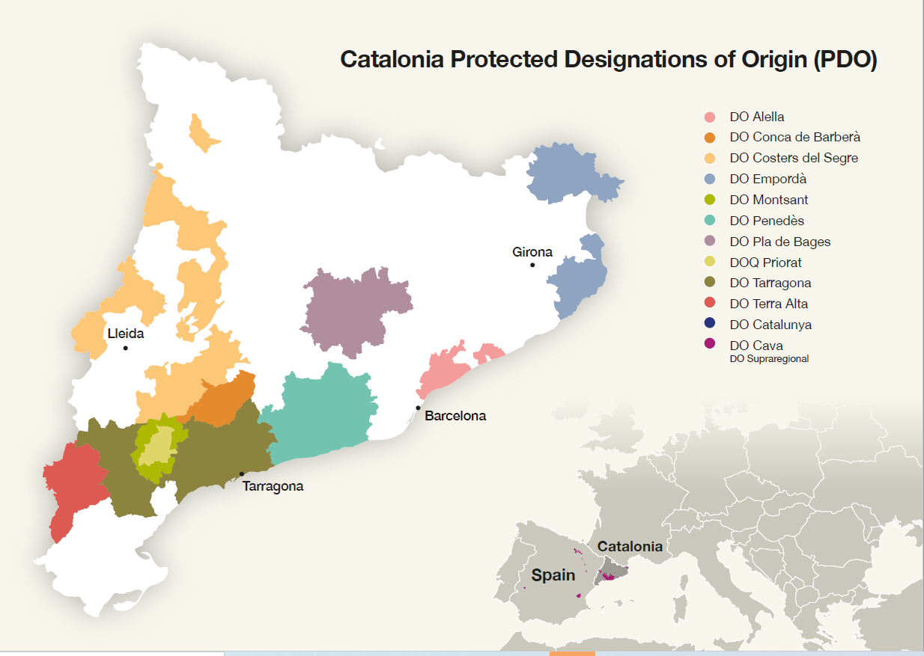
Quality wines from the heart of Europe
Map

Slide 7
History
Quality wines from the heart of Europe
1851: Institut Agrícola Català de Sant Isidre is founded
1872: Josep Raventós makes the first bottles of sparkling wine using the Traditional Method in Sant Sadurní d’Anoia.
Known colloquially as “Champán” or “Xampany”
1880: Phylloxera arrives in Spain; Ravaged vineyards are then replanted with Xarel·lo, Macabeo, and Parellada.
1959: The name “Cava” appears for the first time in a regulatory document.
1970: The name “Champán” is discontinued, and “Cava” is adopted.
1986: “Región del Cava” area is defined.
1991: DOP Cava Regulatory Council is established.

Slide 8
PDO Cava
Quality wines from the heart of Europe
Traditional Method sparkling region
Specific technical conditions for production
Geographically demarcated areas of production
9 months minimum aging on the lees
May be White or Rosé
Quality must be verified by Cava DO Regulatory Board

Slide 9
Base Wine
Quality wines from the heart of Europe
Fruit can be harvested by either hand or machine.
Grapes must be destemmed in the winery.
Extraction yields are restricted to 0.666 liters of wine for every 1 kg of grapes.
Chilled must is racked off from any solids and then transferred to stainless steel tanks.
Primary Fermentation is carried out with selected yeasts at controlled temperatures.
Blending of the base wines occurs after primary fermentation.
Base wine is cooled to encourage precipitation of tartaric acid in the form of crystals.

Slide 10
Tirage
Quality wines from the heart of Europe
Addition of Licor de Tiraje (Liqueur de Tirage) to start the secondary fermentation in the bottle
Licor de Tiraje can be made up of a mix or single component:
Dry yeasts or yeasts in vinous suspension
Sucrose
Concentrated grape must
Rectified concentrated grape must
Partially fermented grape must
Base wine
The addition of Licor de Tiraje must not increase the level of ABV in the base wine by more than 1.5% in total
Bottles are then closed with a stopper and a steel cap or a cork stopper and a staple.

Slide 11
Cava Age Classifications
Quality wines from the heart of Europe
Cava de Guarda:
Traditional Cava (87.1% of PDO total production): 9 months minimum on lees
Cava de Guarda Superior:
Cava Reserva (10.9% of PDO total production): 18 months minimum on lees
Cava Gran Reserva (1.9% of PDO total production): 30 months minimum on lees
Cava de Paraje Calificado (0.1% of PDO total production): 36 months minimum on lees

Slide 12
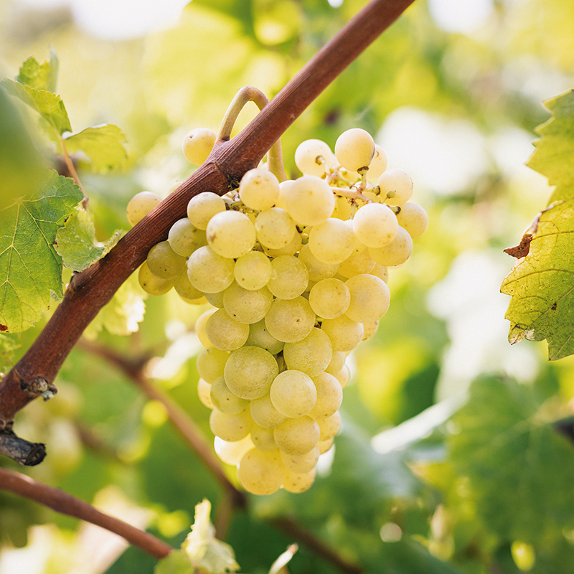
Grape Varieties
Quality wines from the heart of Europe
Macabeo
An indiginous variety with large, compact bunches of grapes
Thin delicate skins
Resistant to frost despite delicate structure
Late-budding variety
Creates wines with balanced acidity and delicate aromas. Very elegant
Adds structure and mouthfeel in blends
Relatively high in antioxidants, therefore it is less susceptible to oxidation.

Slide 13
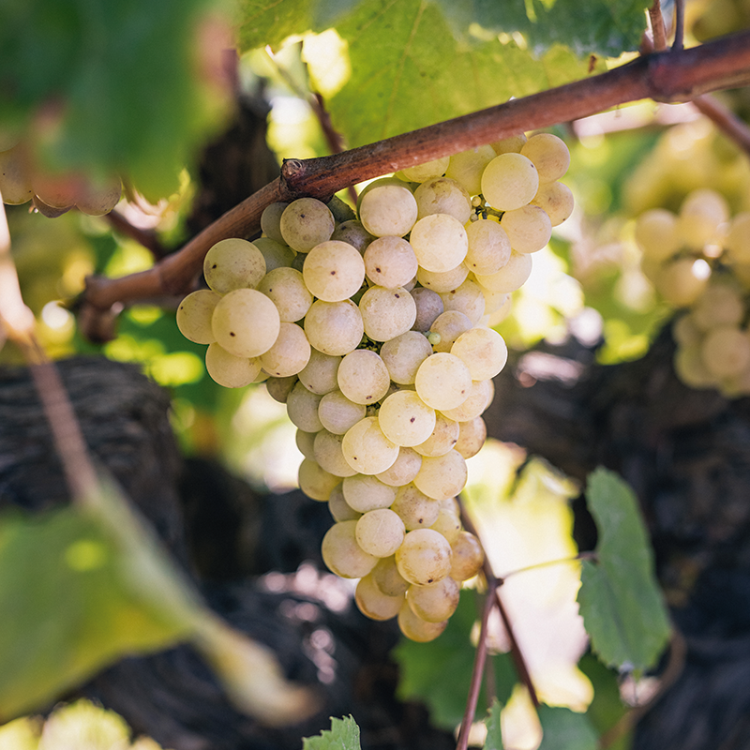
Grape Varieties
Quality wines from the heart of Europe
Xarello
An indigenous variety producing medium-sized, loose bunches.
Grapes are thick skinned and relatively disease resistant.
Challenging to grow in the vineyard; Not conducive to plantings at high altitude.
Tends to grow best at altitudes of less than 400m above sea level.
Buds quite early, yet ripes late; Long growing season
Prone to irregular flowering; Has naturally lower yields
Major structure and power; High acid variety
Used to give Cava fuller body
Notable earthy and herbal/fennel aromas and flavors.
Best suited to long aging.

Slide 14
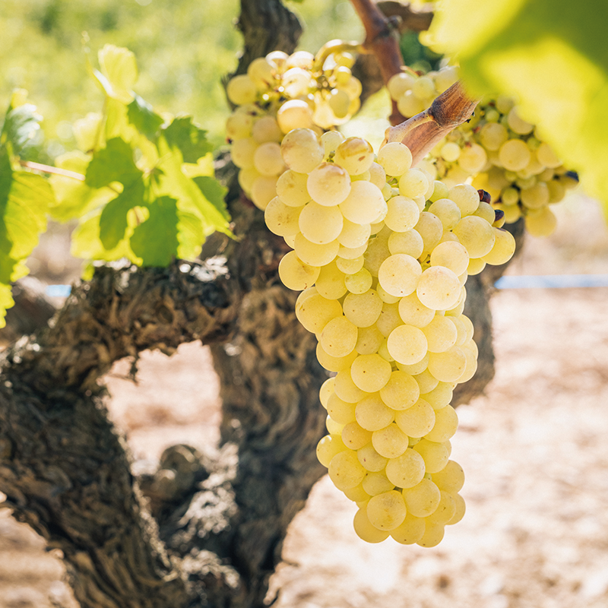
Grape Varieties
Quality wines from the heart of Europe
Parellada
Good-sized bunches with large berries
Typically, the last “classic” variety to be harvested
Does well when planted in high altitudes
Best fruit often comes from vineyards with altitudes between
500 - 800m above sea level.
Grapes are sensitive to heat however
Lower acidity and more moderate alcohol than other “classic” varieties
Adds subtle floral aromas, as well as fruit aromas of apples/quince
Because of its more delicate nature and expression, very useful for
blending
Often used to bring alcohol levels down, and to bring a bit of freshness to
more powerful Xarello-dominant blends.

Slide 15
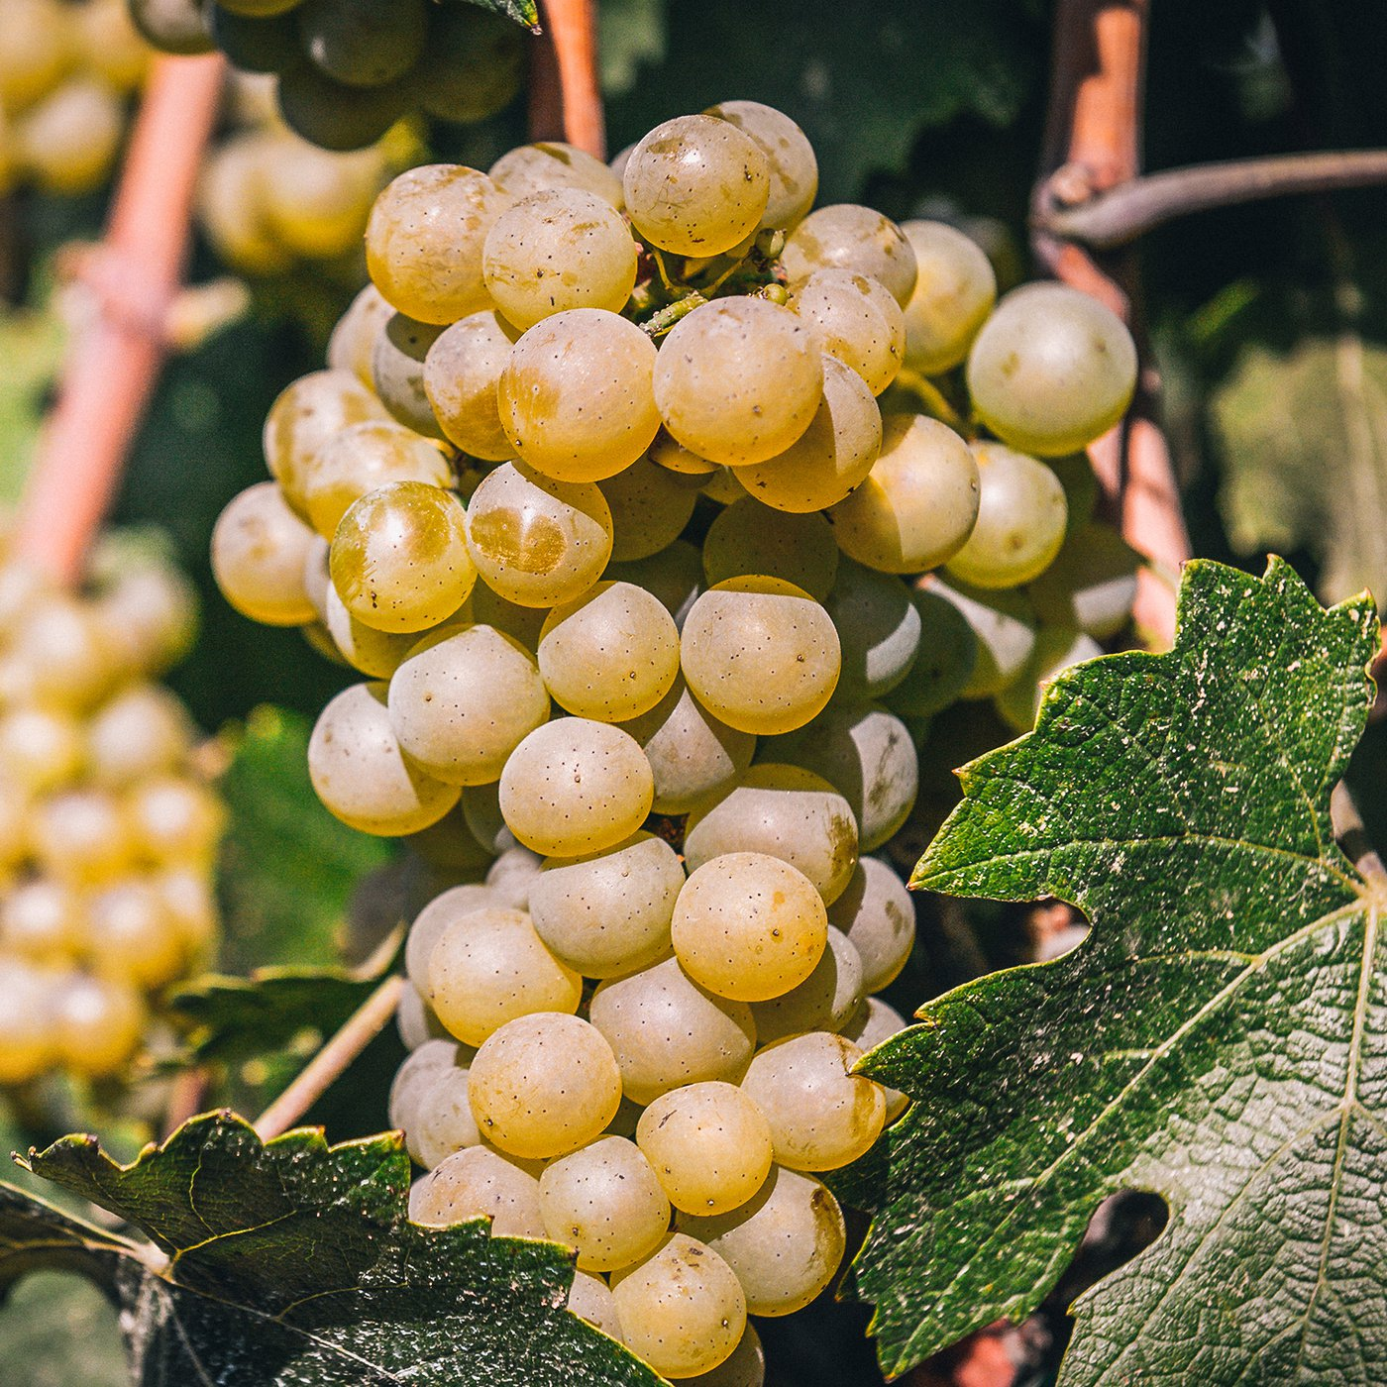
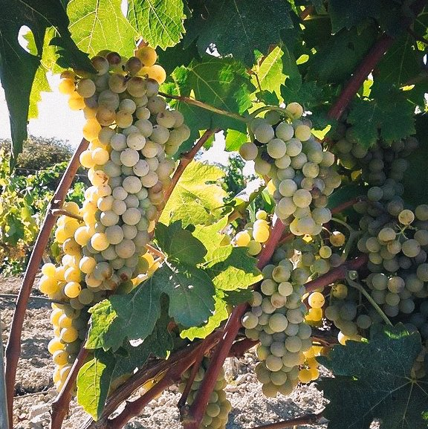
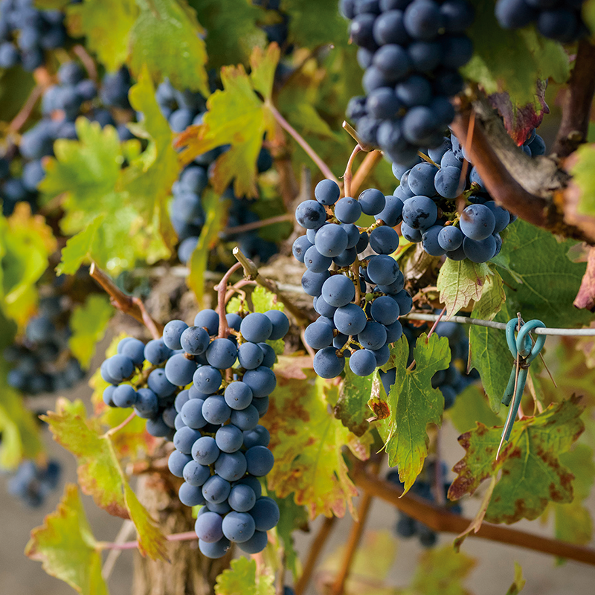
Grape Varieties
Quality wines from the heart of Europe
Chardonnay
First variety to be harvested - mid August.
Difficult to grow; early budburst and sensitive to frost.
Very aromatic; Gives body and high acidity.
Malvasía (Subirat Parent)
Medium-sized bunches with small, yellow berries.
Creates well-structured and fresh wines with beautiful aromatics.
Pinot Noir
Delicate variety susceptible to disease; Early budburst means sensitive to frost.
Grows better in cooler climates and at higher altitudes.
Creates aromatically expressive wines with elegance and body.

Slide 16
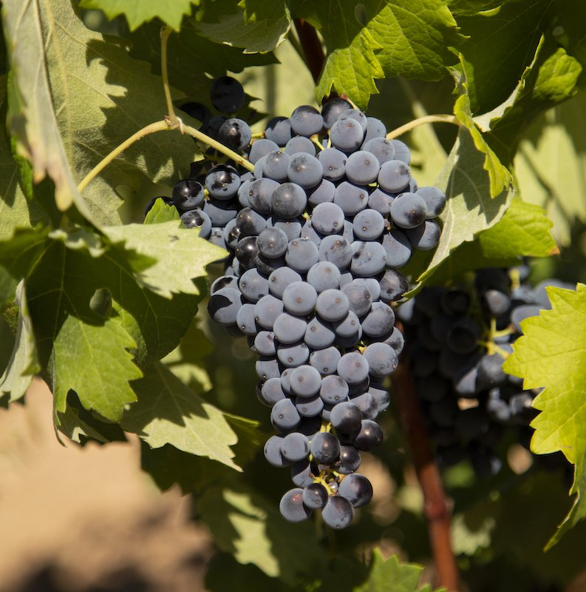
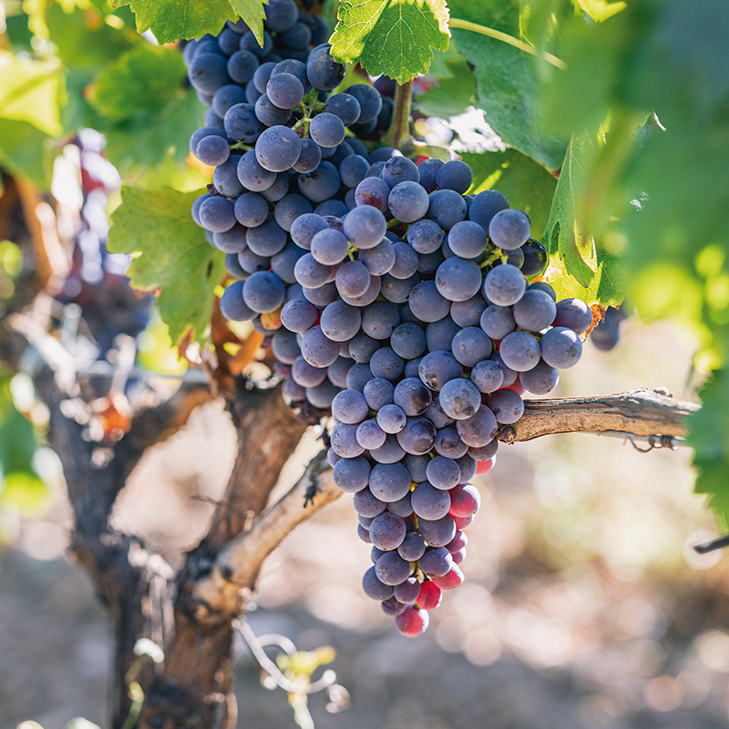
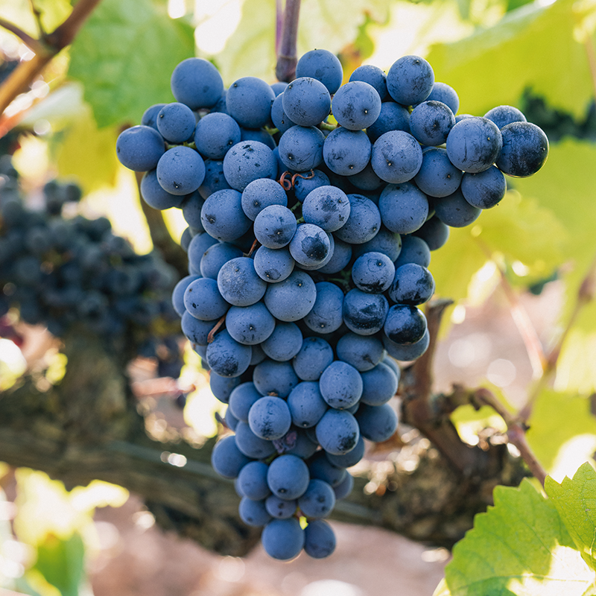
Grape Varieties
Quality wines from the heart of Europe
Trepat
Vigorous grower in the vineyards, producing large, thick-skinned berries.
Budburst is early in the season; however the variety is late ripening.
Used in the production of Rosé wines; Moderate alcohol and acidity
Garnacha Tinta
Grows in compact, medium-sized bunches; Has thin skins
Hardy variety fairly resistant to most major vine diseases and able to
withstand prolonged periods of drought
Produces balanced and aromatic wines with average acidity.
Monastrell
Small, compact bunches with a deep blue color
Used to add weight to blends; tends to have moderately high alcohol levels

Slide 17
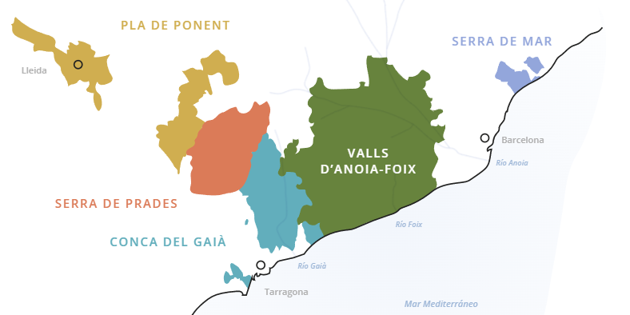
Zones of Cava
Quality wines from the heart of Europe
Comtats de Barcelona
Comtats de Barcelona is the area where more than 95% of
Cava production is concentrated.
Located along the Mediterranean coast close to the iconic and
cosmopolitan city of Barcelona.
In general, the climate is Mediterranean, with some variations
Between the areas closest to the coast and those inland.
These inland areas tend to have a more continental Mediterranean climate.
In geographical terms, the Comtats mainly consist of beautiful valleys or depressions
between mountain ranges of medium elevation, with different orientations, thereby
allowing the cultivation of vines at different altitudes.

Slide 18
Sub-zones of Comtats de Barcelona
Quality wines from the heart of Europe
Serra de Mar
Close to the Mediterranean Sea, barely 15 kilometres north of the city of Barcelona
a unique natural landscape in the middle of these mountains, with views both of the sea and of the city of Barcelona.
Mediterranean climate.
Vineyard altitudes around 90 meters above sea level.
The Xarel-lo grape variety is predominant in this sub-zone.
Known locally as “Pansa Blanca”.
Vine cultivation is generally based on a sauló-based soil, characteristic of the sub-zone.
a sandy, permeable, intensely drained soil that is easy to work with, not very calcareous.
gives the grapes a natural acidity that is ideal for aging in cellars for many months.

Slide 19
Sub-zones of Comtats de Barcelona
Quality wines from the heart of Europe
Valls d’Anoia-Foix
formed by a broad valley located between two mountain ranges: the coastal Massís del Garraf, and the pre-coastal mountain range
It is situated between the historic cities of Barcelona and Tarragona.
Open valley slopes gently down from Montserrat mountains to the sea.
It is formed by a multitude of mounds and small hills shaped by the drainage basins of the rivers Anoia and Foix
The stabilizing influence of the sea, along with the imposing protective wall against the north winds that is formed by the Montserrat massif, give this region a temperate climate
mild winters and summers with some rainfall.
Within this natural framework, the grapes for Cava come from plots that enjoy a diversity of microclimates, as a result of the proximity to the coast and the altitude of some vineyards
as high as 750m above sea level.
This diversity allows Cava's three main native grape varieties to fit into the region's different landscapes according to their needs
Xarel-lo predominating in the coastal area,
Macabeo in the valley
Parellada in the higher areas.

Slide 20
Sub-zones of Comtats de Barcelona
Quality wines from the heart of Europe
Conca del Gaià
crosses the regions of Tarragonès and Alt Camp.
an emblematic area where the vineyards of Roman Hispania were established.
name refers to the river Gaià that crosses this sub-zone
Vineyard altitudes are between 100 - 400 meters above sea level.
typical Mediterranean climate of mild winters and hot summers, tempered by the sea breeze.
sub-zone consists of a plain open to the sea, which slopes gently upwards from the Mediterranean, culminating in the peaks of the coastal mountain range.
Predominant varieties are Xarel-lo Macabeo Parellada

Slide 21
Sub-zones of Comtats de Barcelona
Quality wines from the heart of Europe
Serra de Prades
North of Tarragona province and bordering the region of Lleida.
Named after the Prades mountains, an outstanding morpho-structural part of the Catalan pre-coastal mountain range.
Sub-zone stands out for its geological formation: a river basin or valley surrounded by mountains, on whose southern slope the Serra de Prades stands out, shaped by the erosive action of the Francolí river and its tributaries.
Altitudes range from 350 to 600 meters above sea level.
Serra de Prades enjoys a very particular microclimate
The influence of the Mediterranean blends with winds from the interior, of a continental nature, in what could be described as a transitional Mediterranean climate with greater thermal contrasts
This allows characteristics that are more typically found in white grapes from cold climate zones.
This microclimate favors the cultivation of the native Trepat variety, although Macabeo and Parellada are also grown.

Slide 22
Sub-zones of Comtats de Barcelona
Quality wines from the heart of Europe
Pla de Ponent
Innermost sub-zone of the Comtats of Barcelona area
Also known as "Terres de Ponent".
The inland climate, which is more continental being further from maritime influence, is dry and has long hours of sunshine
A high level of thermal contrast between day and night.
Scarce rainfall, which mainly occurs in spring.
Winters with frost and fog.
Vineyards are located at an altitude of between 200 and 400 metres
Essentially a flat landscape with gentle undulations.
Characterised by well-drained soils with scant fertility.
Predominant varieties are Chardonnay, Pinot Noir, and Xarel-lo.

Slide 23
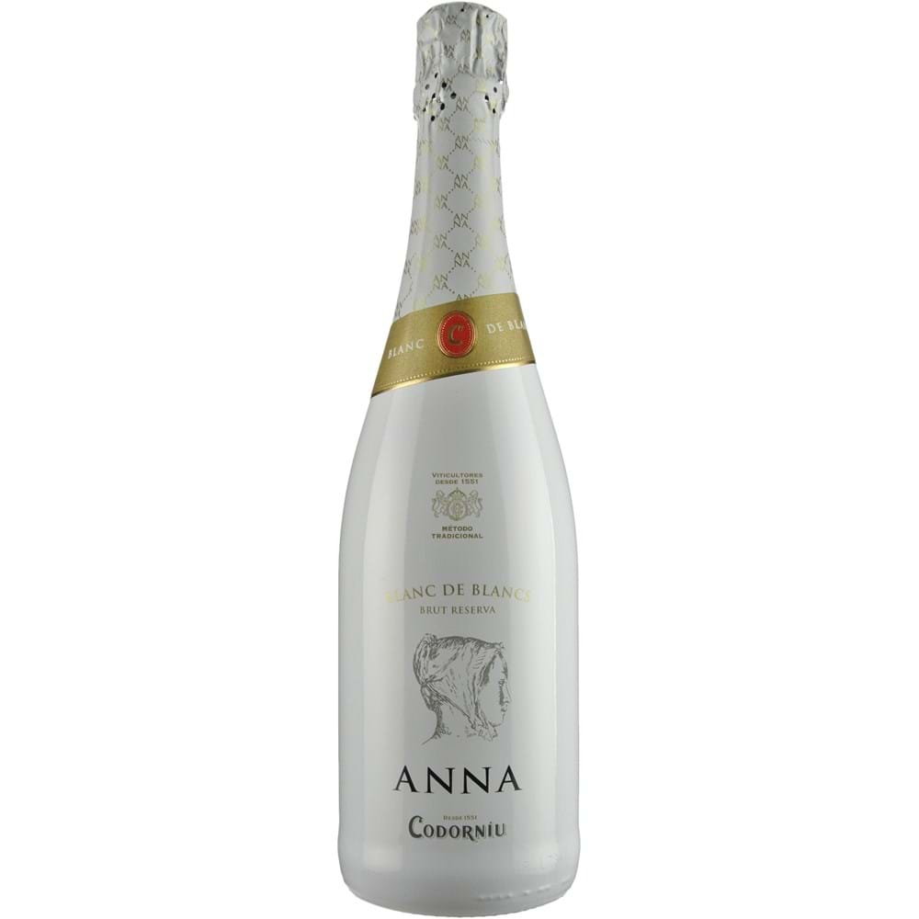
Anna de Codorniu Blanc de Blancs Brut Reserva NV
Quality wines from the heart of Europe
70% Chardonnay
15% Parellada
7.5% Macabeo
7.5% Xarello
15 months on lees
11.5% ABV
Dosage: 8g/L

Slide 24
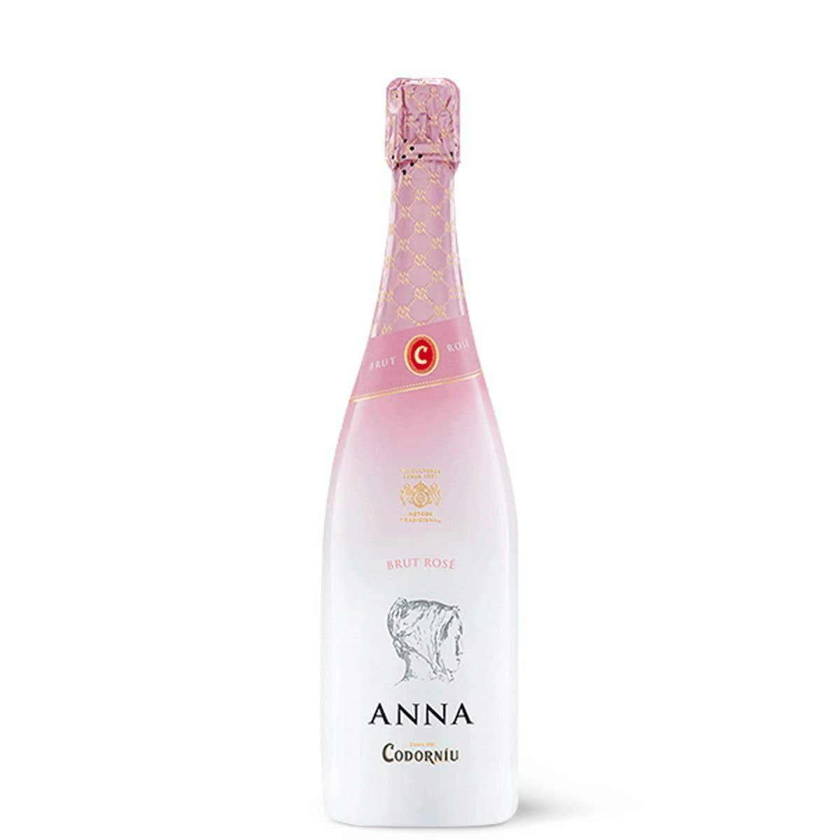
Anna de Codorniu Brut Rosé NV
Quality wines from the heart of Europe
70% Pinot Noir
30% Chardonnay
12 months on lees
12% ABV
Dosage: 6 - 8g/L

Slide 25
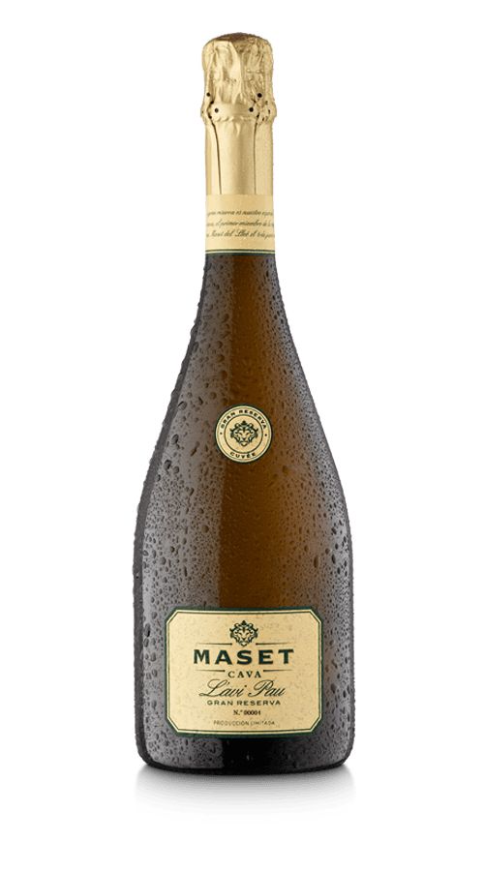
Maset L’avi Pau Gran Reserva Brut Nature 2017
Quality wines from the heart of Europe
30% Xarello
25% Macabeo
25% Parellada
20% Chardonnay
36 Months on the lees
11.5% ABV

Slide 26
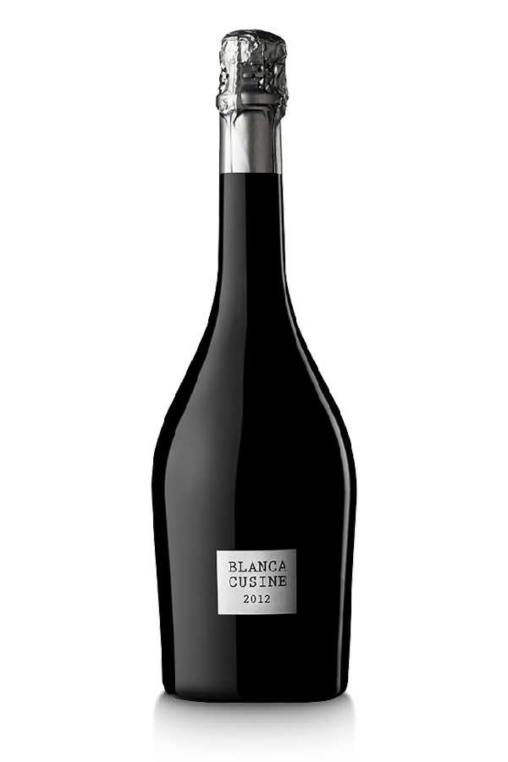
Parés Balta Blancá Cusiné 2012
Quality wines from the heart of Europe
81% Xarello
9% Chardonnay
10% Pinot Noir
80 months on the lees
12% ABV
No Dosage

Slide 27
The content of this promotion campaign represents the views of the author only and is his/her sole responsibility. The European Commission and the European Research Executive Agency (REA) do not accept any responsibility for any use that may be made of the information it contains.

